Slide 1
Methodology for Data Gathering

Slide 2
Data sources
Kaggle Superfund site JSON
Data source provided Latitude and longitude of all the Superfund sites based on addresses. There are 1344 active superfund sites
www.kaggle.com
Cancer incidence rates
Data source provided Cancer incident rates for each state for multiple types of cancers
www.cancer.orgstatecancerprofiles.cancer.gov/index.html
Team picked the top 4 cancer types. Downloaded csv files for each type. Combined all cancer information into on csv.

Slide 3
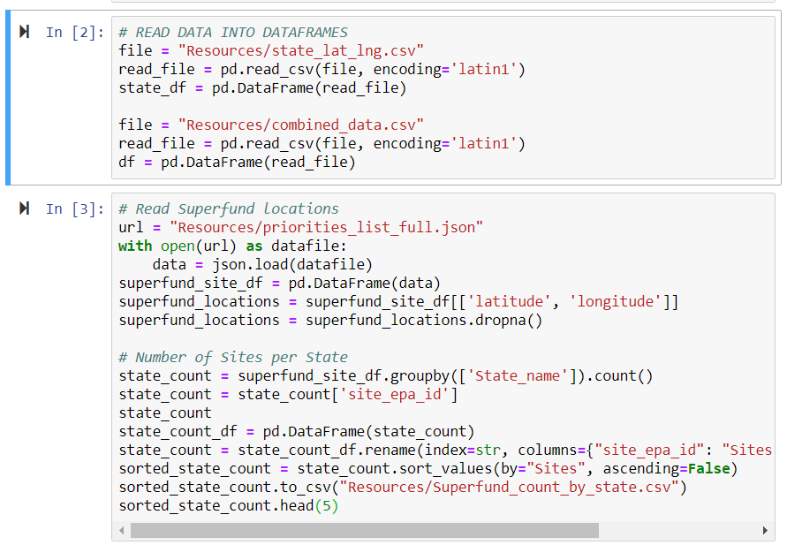
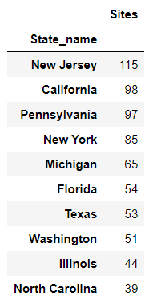
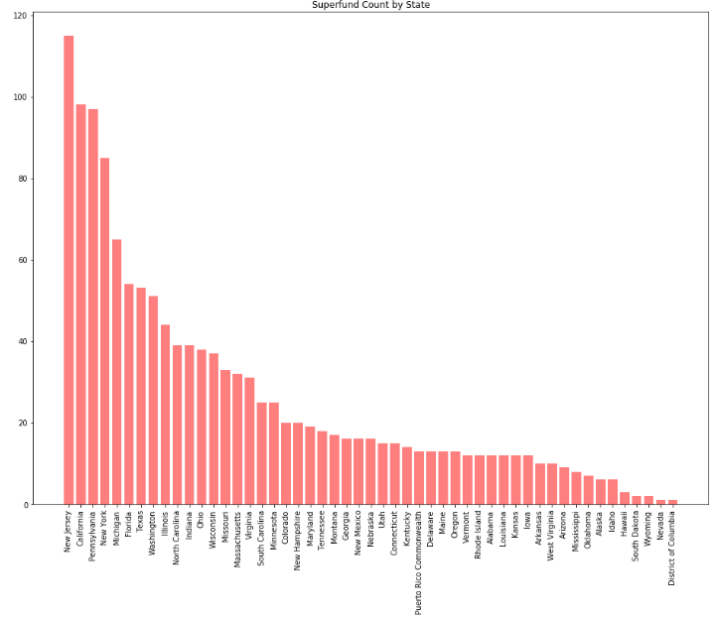
Data wrangling
Read Superfund JSON
Superfund Site Json
Built dataframe of Superfund sites per state
Read Cancer data per state
Data was displayed per state
Each team member created csv files per state and created 51 total csv files (1 for each state)
Wrote Python routine to read in each state csv and merge data into on combined cancer set per state

Slide 4
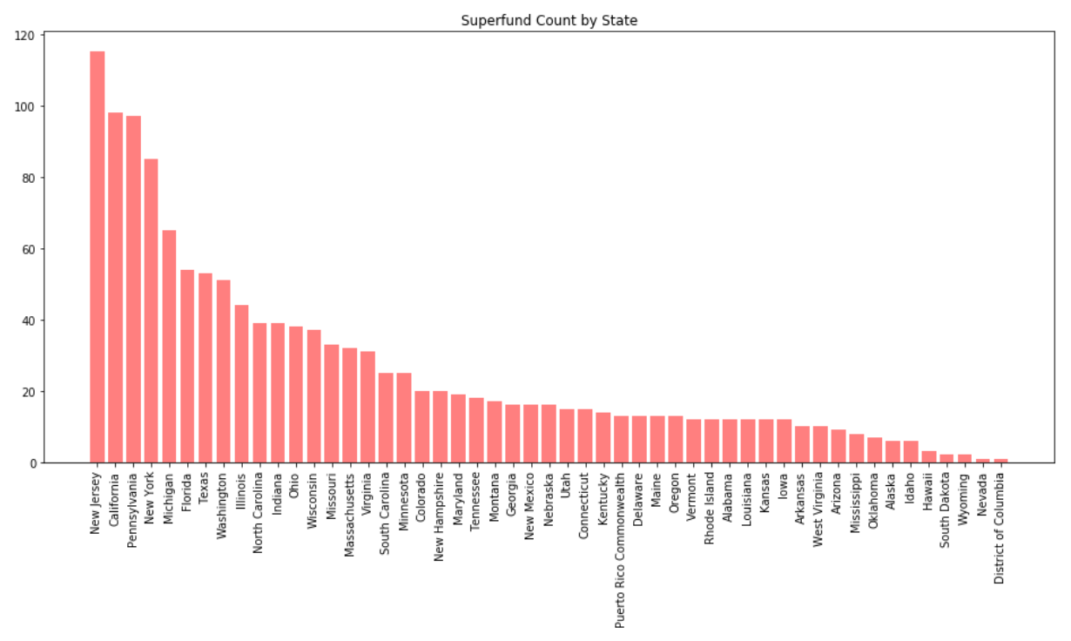
Superfund count per State

Slide 5
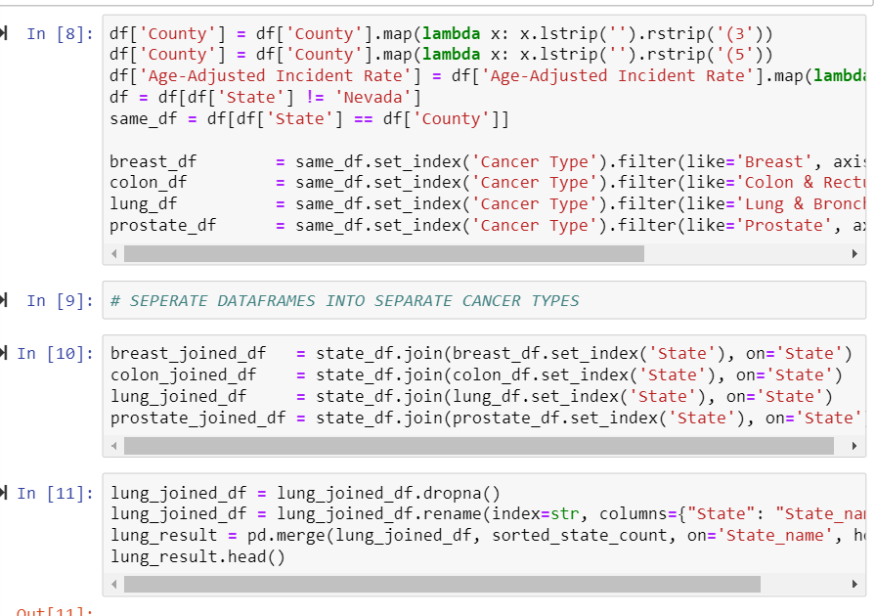
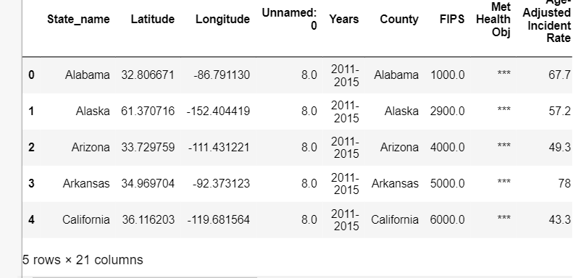
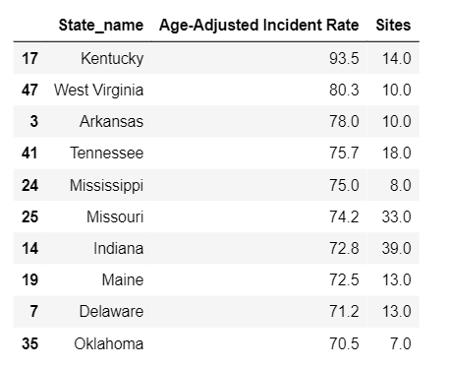
Data wrangling
Split Data into 4 data sets, each set contained all cancer types for all 50 states.
Merged lat/lng information into each dataframe for each cancer type
Created subset of each cancer type with Incident Rate and Superfund count per state
Created Scatter plots for each Cancer type and looked for correlations visually.
Fed each of the reduced dataframes into the person function to look for correlations statistically

Slide 6
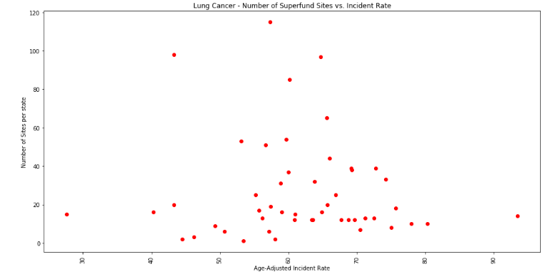
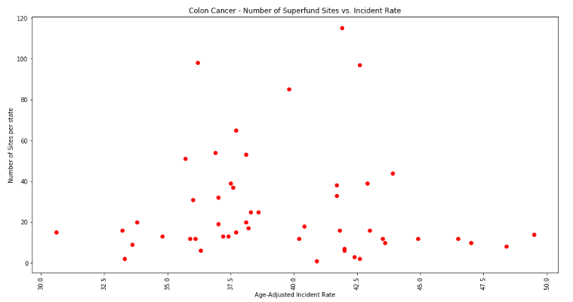
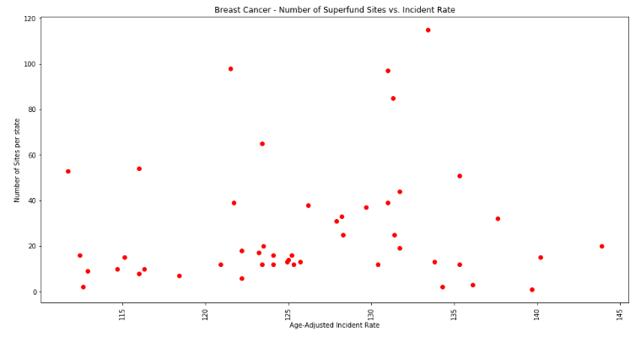
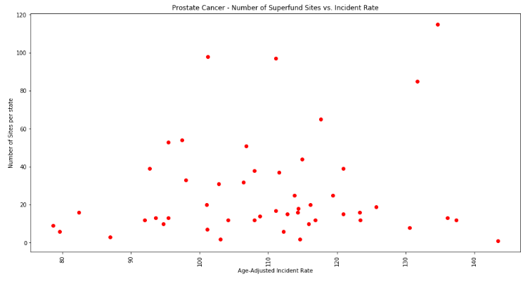
Scatter Plots correlation

Slide 7
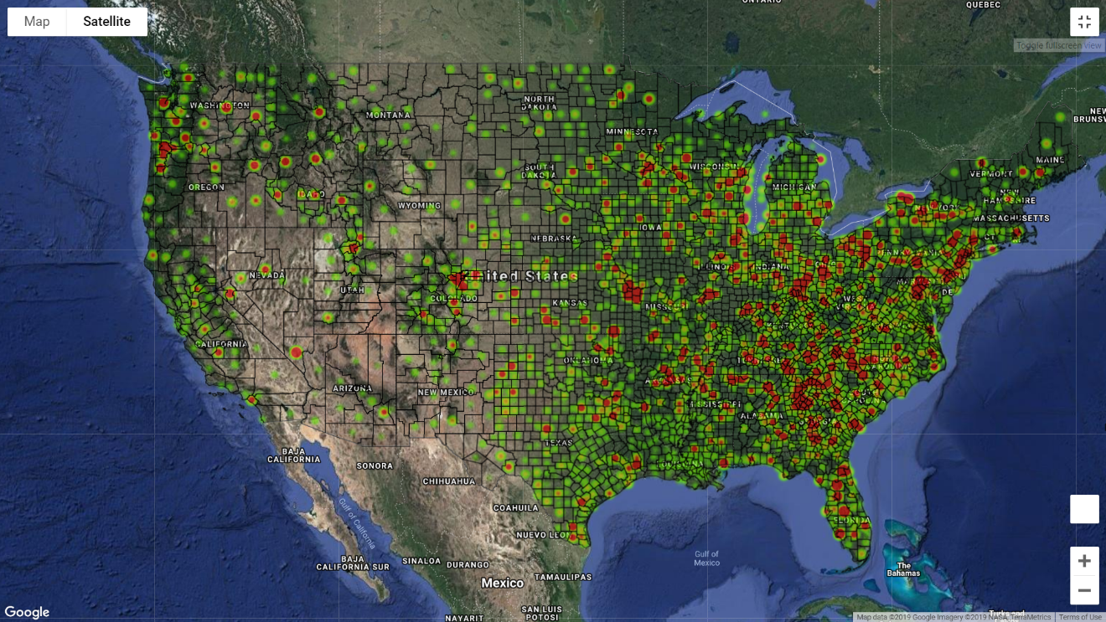
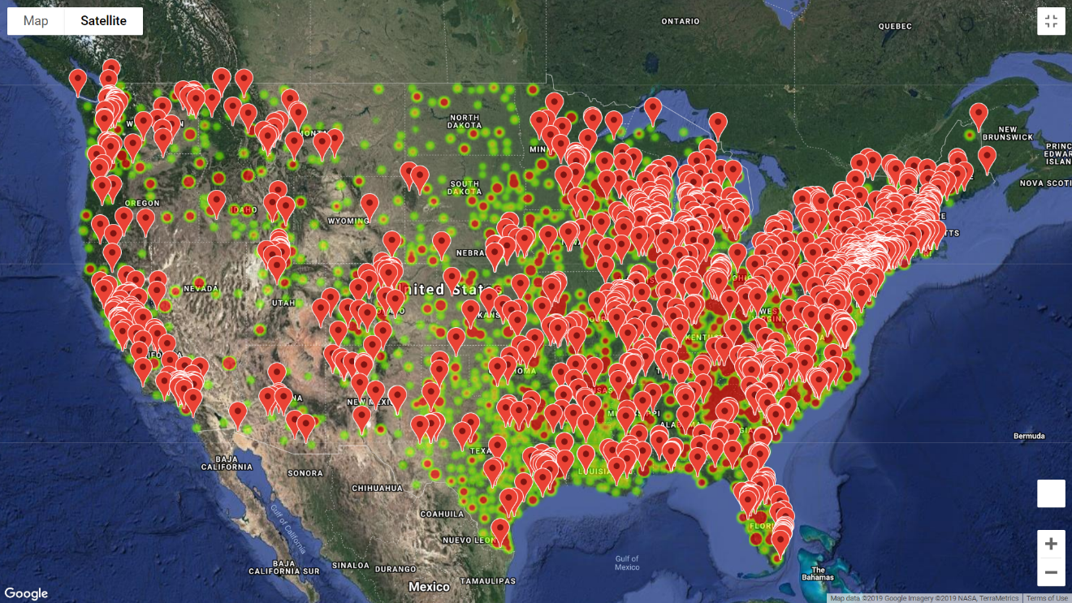
Visualizations
Created visualizations using heat maps and marker locations to search for correlations on a map for each cancer type
Read cancer data and superfund json data
Used google api functionality to generate a heatmap layer, location marker layer, and geojson layer to visualize the county boarders all on the same map.

